Slide 1
Is NIL fairly compensating college athletes?
Ben Quick & Austin Liu

Slide 2
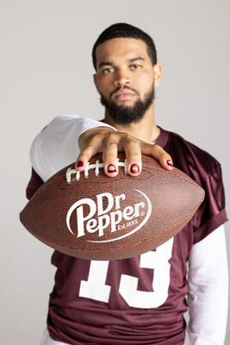
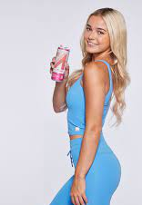
What is NIL?
Name
Image
Likeness

Slide 3
The creating and posting of content accounts for 43.7% of all NIL Compensation

Slide 4
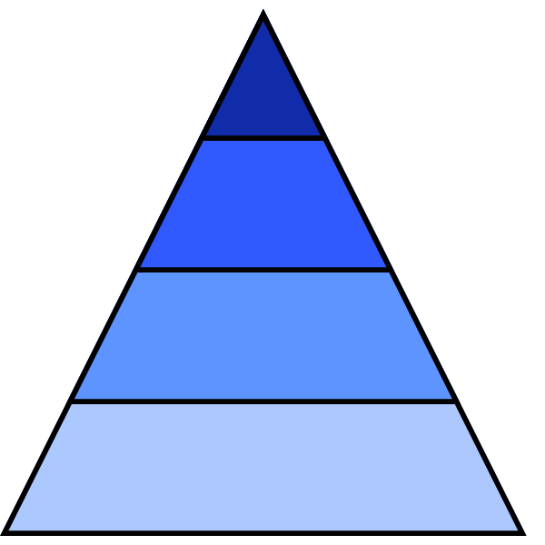
Our Influencer Classification by Follower Count
Top-tier (30k - 50k)
Mid-tier (10k - 30k)
Micro (5k - 10k)
Nano (0-5k)

Slide 5
Are NIL athletes fairly compensated compared to regular influencers
?

Slide 6
Athletes are dominating engagement
Engagement Rate = Interactions (Likes, Comments, Shares)
More Engagement = More Payment per Post… Right?
Followers
Average among Influencers 1-3%
Average among Student-Athletes 5.5%
Source: Sports Business Journal
Notes:
https://www.sportsbusinessjournal.com/SB-Blogs/OpEds/2023/07/25-Carter.aspx#:~:text=For%20traditional%20influencers%20on%20Instagram,engagement%20rate%20of%20about%205.5%25.

Slide 7
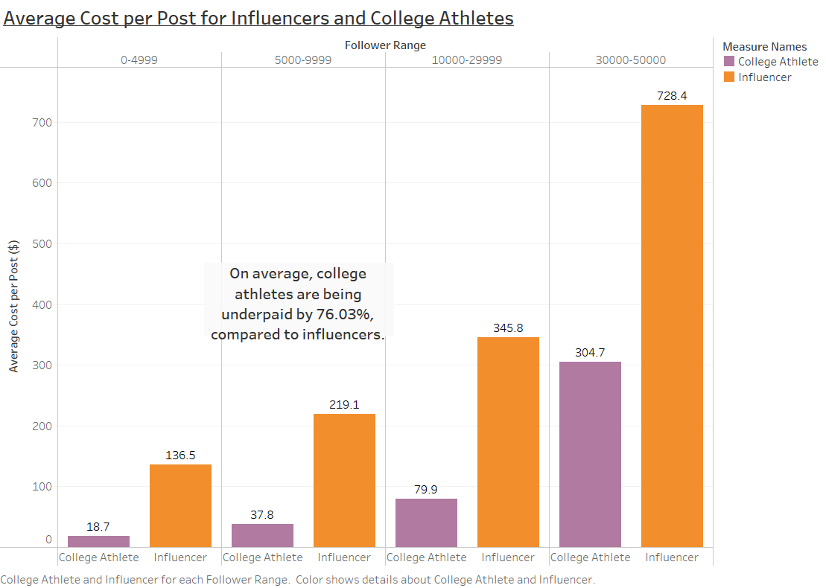
NIL athletes are underpaid by 76%
Source: Collabstr Influencer Marketplace

Slide 8
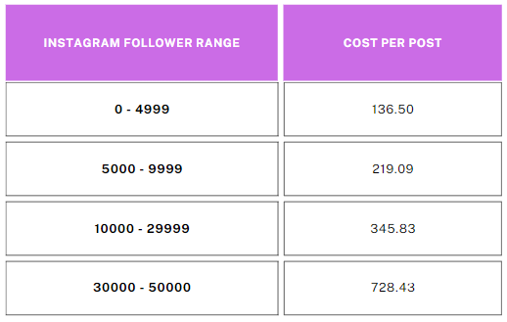
Recommendation

Slide 9
